Slide 1

딥러닝 (Deep Learning)
Homework 2
Object Recognition

Slide 2

Programming assignments
Deep Learning Basic MLP
Object Recognition ResNet
Face Recognition Free choice model
Object Detection YOLO
Image Generation GAN, CGAN, DCGAN
NLU CNN for Sentence Classification
NLG LSTM, Transformer
SSL for Computer Vision ViT
SSL for NLP BERT
LLM ChatGPT

Slide 3
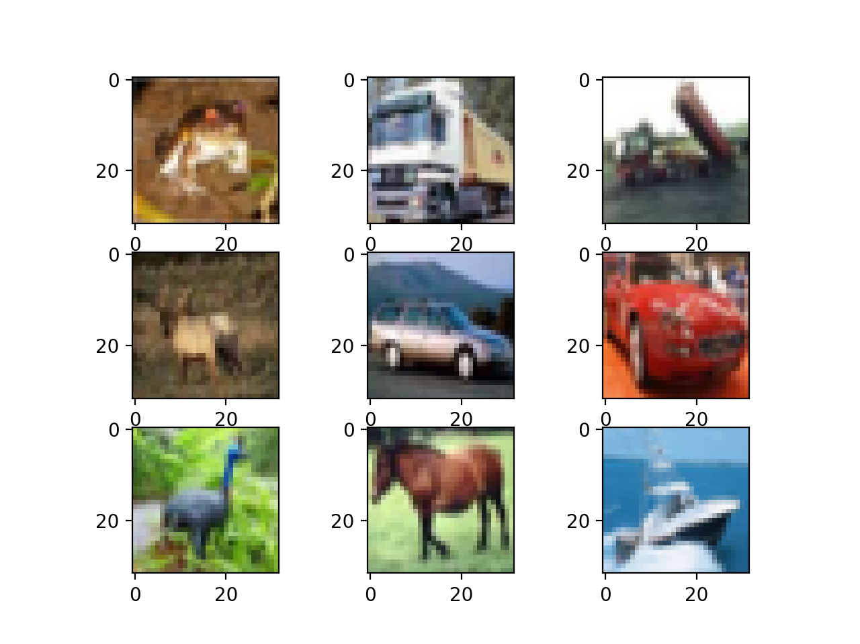
Homework 2: ResNet
[Objective]
Your model should classify the images into 10 classes.
[Requirements]
1. Implement ResNet32 model using the CIFAR-10 dataset by changing various hyper-parameters.
(Basic code is provided)
2. You should experiment with the settings stated in the evaluation report and report the result of each setting.
3. You should attach the plot of the validation dataset accuracy plot.
4. You should report the experimental results.
(all kinds of additional experiments are recommended)
model
"Truck"

Slide 4
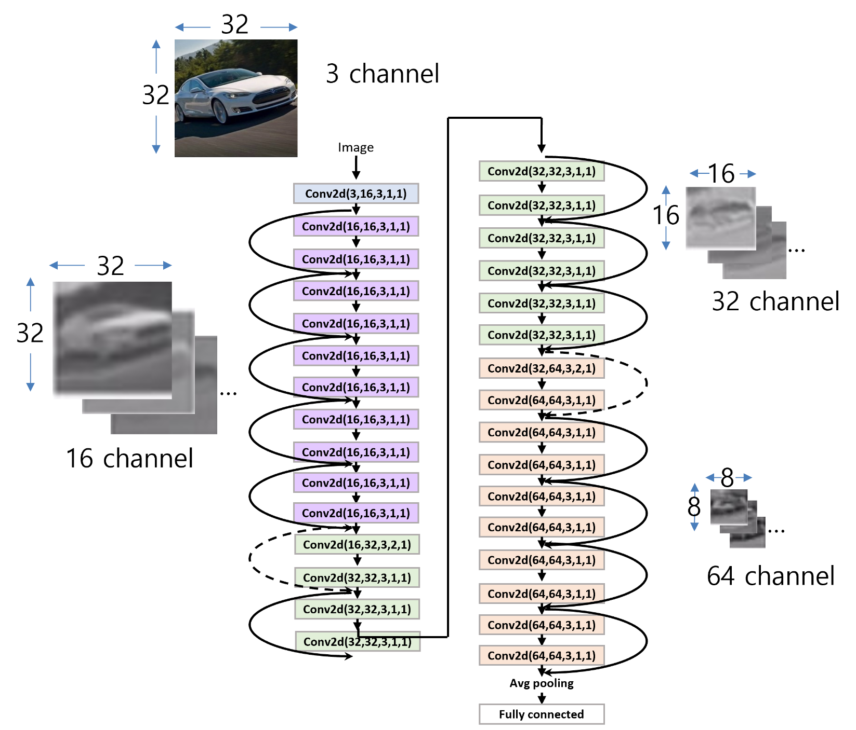
Homework 2: ResNet

Slide 5
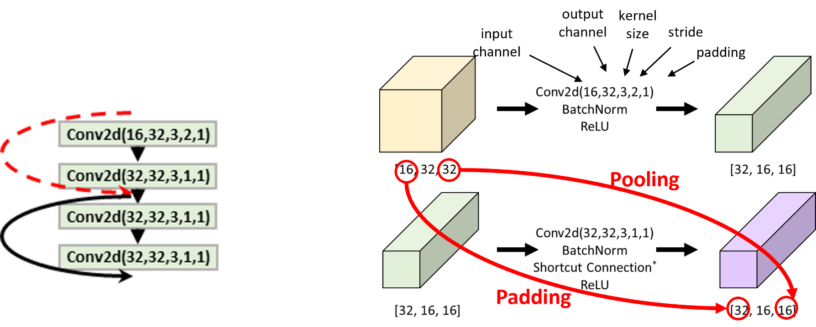
Homework 2: ResNet
class IdentityPadding(nn.Module):
def __init__(self, in_channels, out_channels, stride):
super().__init__()
self.pooling = nn.MaxPool2d(kernel_size=1, stride=stride)
self.add_channels = out_channels - in_channels
def forward(self, x):
# before padding x: torch.Size([128, 32, 16, 16])
x = F.pad(x, [0, 0, 0, 0, 0, self.add_channels])
# after padding x: torch.Size([128, 64, 16, 16])
x = self.pooling(x)
# after pooling x: torch.Size([128, 64, 8, 8])
return x

Slide 6
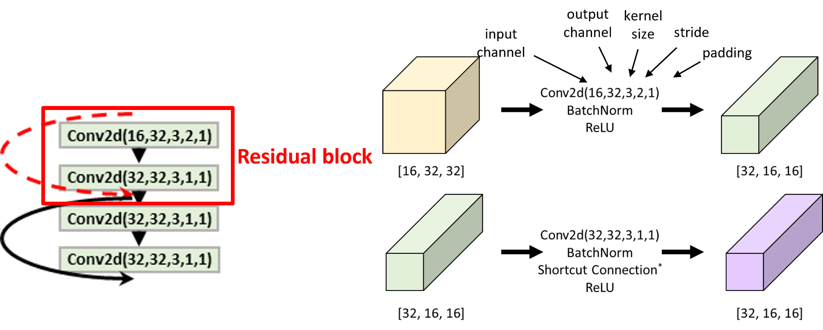
Homework 2: ResNet
class ResidualBlock(nn.Module):
def __init__(self, in_channels, out_channels, stride=1, down_sample=False):
super().__init__()
self.conv1 = nn.Conv2d(in_channels, out_channels, kernel_size=?, stride=?,
padding=?, bias=False)
self.bn1 = nn.BatchNorm2d(out_channels)
self.relu = nn.ReLU(inplace=True)
self.conv2 = nn.Conv2d(out_channels, out_channels, kernel_size=?, stride=?,
padding=?, bias=False)
self.bn2 = nn.BatchNorm2d(out_channels)
self.stride = stride
if down_sample:
self.down_sample = IdentityPadding(in_channels, out_channels, stride)
else:
self.down_sample = None

Slide 7
Homework 2: ResNet
class ResidualBlock(nn.Module):
def __init__(self, in_channels, out_channels, stride=1, down_sample=False):
…
def forward(self, x):
shortcut = x
x = self.conv1(x)
x = self.bn1(x)
x = self.relu(x)
x = self.conv2(x)
x = self.bn2(x)
if self.down_sample is not None:
shortcut = self.down_sample(shortcut)
x += shortcut
x = self.relu(x)
return x

Slide 8
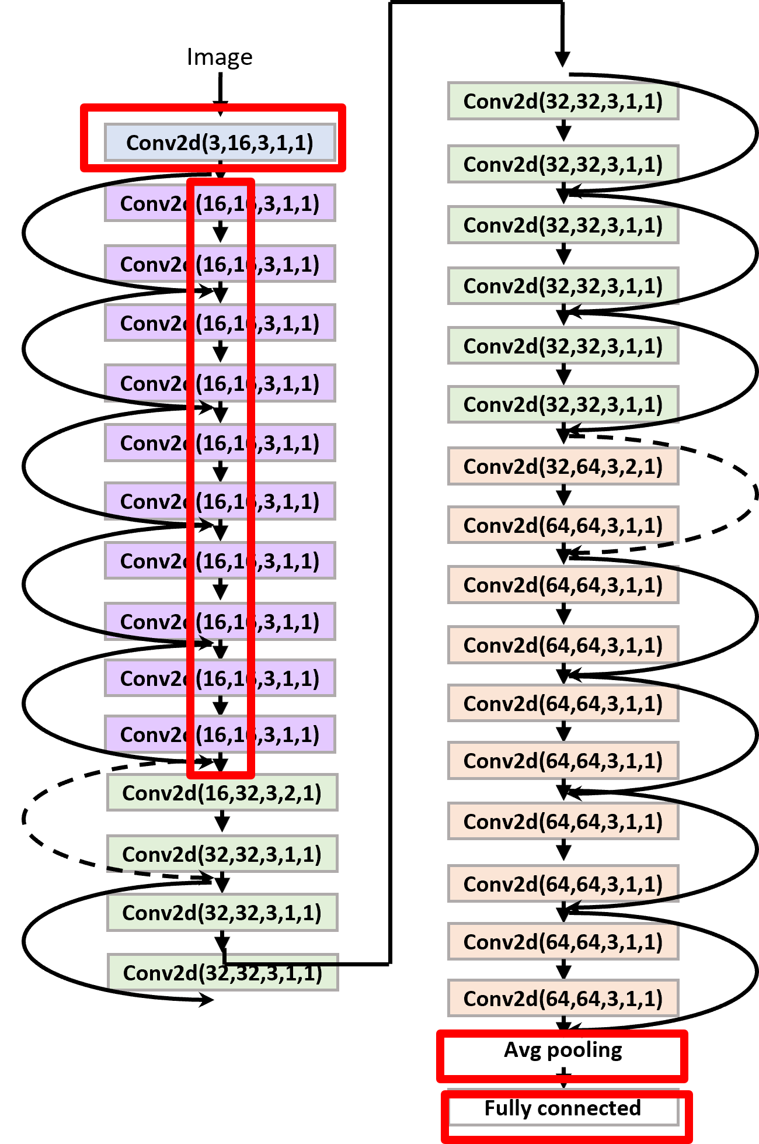
Homework 2: ResNet
class ResNet(nn.Module): def __init__(self, num_layers, block, num_classes=10):
super().__init__()
# input img : [3, 32, 32]
self.num_layers = num_layers
self.conv1 = nn.Conv2d(in_channels=?, out_channels=?,
kernel_size=?, padding=?, bias=False)
self.bn1 = nn.BatchNorm2d(16)
self.relu = nn.ReLU(inplace=True)
# feature map size = [16,32,32]
self.layers_2n = self.get_layers(block, 16, 16, stride=1)
# feature map size = [32,16,16]
self.layers_4n = self.get_layers(block, 16, 32, stride=2)
# feature map size = [64,8,8]
self.layers_6n = self.get_layers(block, 32, 64, stride=2)
# output layers
self.pool = nn.AvgPool2d(8, stride=1)
self.fc_out = nn.Linear(64, num_classes)
num_layers = 5

Slide 9
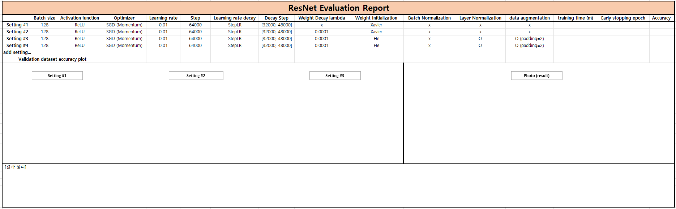
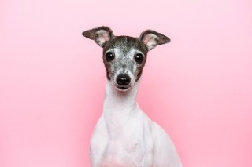
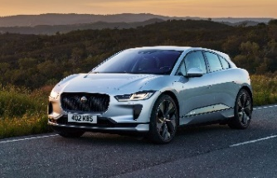
Homework 2: ResNet
[Evaluation report]
dog
car

Slide 10
Homework 2: ResNet
Evaluation Criteria
Simplicity | How concisely did you write the code? - 배점 2점
Performance | How well did the results of the code perform? - 배점 2점 acc 90%이상 달성: 1점 개인 사진 추론: 1점
Brevity and Clarity | How concisely and clearly did you explain the results? - 배점 1점

Slide 11
Homework 2: ResNet
Due to : ~ 4/7 (Mon) 23:59:59
Submission : Online submission on cybercampus
Your submission should include
The whole code of your implementation
The evaluation report
You must implement the components yourself!
File name : StudentID_Name_HW2.zip

Slide 12
Q&A

